Slide 1


Annual General Meeting
This presentation contains alt text
3rd July 2023
One Strawberry Lane

Slide 2

Itinerary
10:00 | Housekeeping
10:05 | Getting to know you
10:25 | Testimonials
10:45 | Over to you
11:15 | Moving forward
11:45 | End
Notes:
Tori

Slide 3
Getting to know you
The Sock Exchange
Notes:
1000 - 1020 Arrival and socks (super sock idea - HPs)
Victoria

Slide 4
Celebrating our work so far
Testimonials
Notes:
10:25

Slide 5
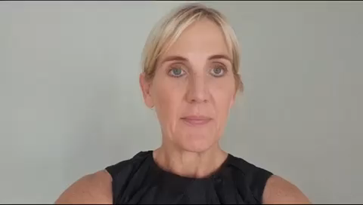
Jo Mackintosh
NCA (Formerly) & Northumbria Trust
Notes:
Intro testimonial - Jo
1025 – 1045
Tori

Slide 6
Andrea Love
Macmillan
Notes:
Intro testimonial - Andrea
1025 – 1045
Tori

Slide 7
Alison Featherstone
Northern Cancer Alliance
Notes:
Intro testimonial - Alison
1025 – 1045
Tori

Slide 8
Over To You
Notes:
10:50 Anna

Slide 9


How do we connect better with each other to network and share our best practices?
ⓘ Start presenting to display the poll results on this slide.

Slide 10
How can we get better feedback from patient representatives?
ⓘ Start presenting to display the poll results on this slide.

Slide 11
How do we grow our representation?
ⓘ Start presenting to display the poll results on this slide.
Notes:
Hard stop 11:20

Slide 12
Moving Forward
Next Milestone: Establish NCV as Charitable Incorporated Organisation (currently in progress)
Notes:
1120-1140 Moving Forward
Michael

Slide 13
Meet Our Trustees
Jane Dennison
Clare Hawkes
Thomas Monaghan
Liam Davidson
Notes:
1115 -1145 Moving Forward
Michael

Slide 14
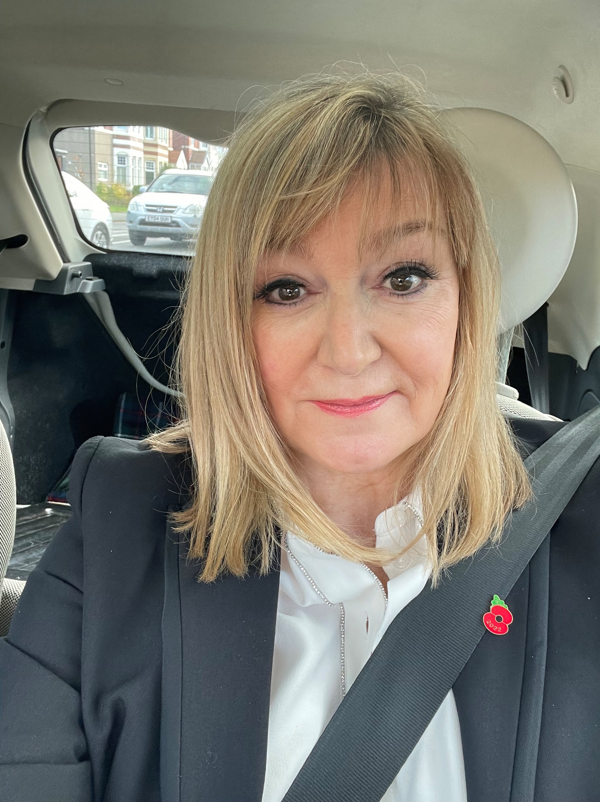

Jane Dennison
I am the CEO of Dragonfly Cancer Trust, which is a small charity based in the Northeast of England. We have a national reach and collaborate with hospices and hospitals across the U.K.
I am an entrepreneur and have created successful businesses and gained recognition and awards within the region for my efforts. I am a mum to three grown up children and a very new grandmother!
Sadly, like many people I have lived experience of cancer thought both my profession and personal life.
The work that I do has strong synergy with the work of Norther Cancer Voices, albeit a different age range, we also aim to provide the best possible care and support for cancer patients and their families.

Slide 15
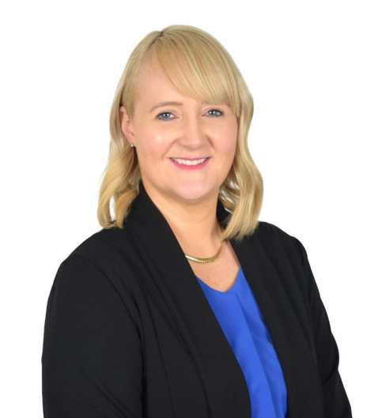
Clare Hawkes
My working life has given me a natural curiosity to make things better and over the years. I have a wealth of experience of improving customer and colleague experiences and journeys in a corporate environment.
My son has given me first hand experience of how amazing the NHS are and the fantastic care they give. But I know there is more that can be done to improve the experiences of those needing care.
I hope my experience will make me an asset to Northern Cancer Voices and that I will be able to add value and give guidance, support and time to this worthwhile organisation as it takes it next step in what I am sure will be an epic journey.

Slide 16
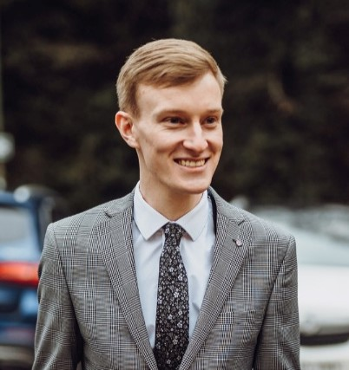
Thomas Monaghan
Having worked with Northern Cancer Voices since their establishment in various ways, I am delighted to be joining their Trustee Board as they progress to the next stage of their organisational development.
Every time I hear that 1 in 2 people will develop some form of cancer in their lifetime I am reminded of why Northern Cancer Voices is needed - so that cancer patients, their families, and carers get the highest quality of care & support they need, when they need it most.
It is only through listening to the voices of those who have been affected by this awful disease that real system change can be brought about and I firmly believe that Northern Cancer Voices will continue to demonstrate this on a local, regional, and national level.

Slide 17
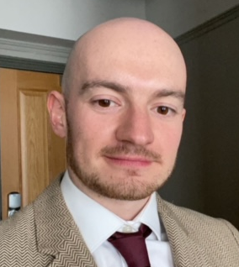
Liam Davidson
It is a great pleasure to join the Board of Trustees of Northern Cancer Voices (NCV) as they move to a recognised charitable status.
Having followed NCV over the last few years it has been wonderful to see the passion and heart of the organisation as they bring together individuals and communities affected by cancer. The disease has affected so many families, as well as my own, and it is a privilege to work with a team that aim to improve cancer outcomes in the northern region.
Notes:
Hard stop 1140

Slide 18
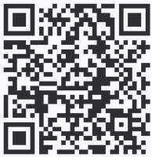
Try our New Survey Tool!
Notes:
1140 - 1150
NOTE FROM ANNA: At this point, I’ll flick over to the “present mode” of Microsoft forms so we can see the results come in live.
It’ll be visible here on the day but you’ll have to be logged into my personal 365 to see it. https://forms.office.com/Pages/AnalysisPage.aspx?AnalyzerToken=3fU9WdxTFAJx1ckGDdnasOU5d6um19gn&id=DQSIkWdsW0yxEjajBLZtrQAAAAAAAAAAAANAAcxQ0XZUQVZXOURNNFFYSUhaMldEOFQ2Qk4xVk5JQi4u

Slide 19
Thank you!
Notes:
1150-12
Tori

